Slide 1
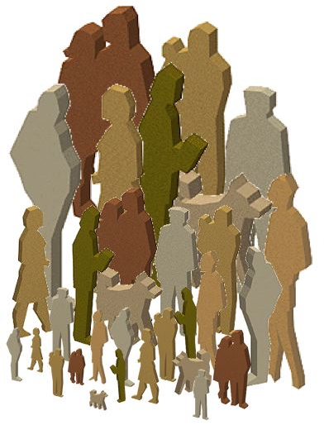

By
Rabia Sarwat

Slide 2

Culture
Definition : Culture is the knowledge, language and values, customs and material objects that are passed from person to person and from one generation to the next in a human group are society.
Importance : Culture is essential for our individual survival and communication with other people.

Slide 3
Material and non material culture
Material Culture, Definition:
A component of culture that consists of physical or tangible creations such as clothing, shelter and art that members of society make use and share.
Non material Culture, Definition:
A component of culture that consists of abstract or intangible human creations of society such as attitude, beliefs and values that influence people’s behavior.

Slide 4
Cultural Universal
These are the Customs and practices that occur across all society.
This category includes appearance such as bodily adornment and hairstyles, activities such as sports, dancing, games, joking and visiting, social institutions such as family law and religion and customary practices such as gift giving and hospitality.

Slide 5
Major Components of Culture
Non material culture components are
Symbols
Language
Values
Norms
These components contribute to harmony and strife in society.

